Slide 1
Purchasing
Interim

Slide 2
Organizational Benefits
Improved Receiving
More Accurate Data
Green (less paper)
Improved analytics

Slide 3
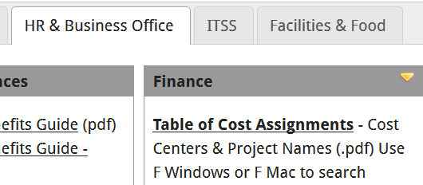
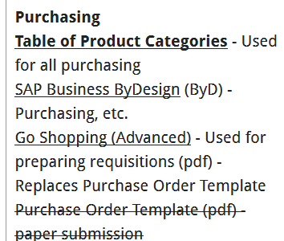
Limitations
This is a shopping cart / requisition
  Finance issues the Purchase Order
Need to know Cost Assignment
  Cost Center
  Project
  See Chart
Need to know Product Category
  See Chart

Slide 4
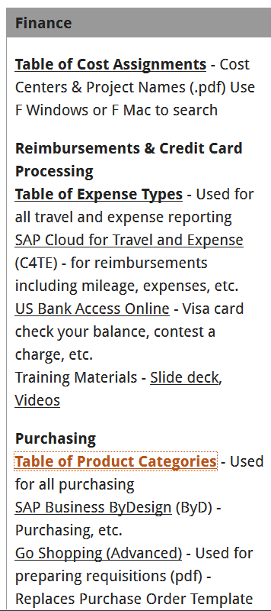
Resources for you
Check Cost Assignment
Cost Center
Project
Check Table of Product Categories
Review Training Slides

Slide 5
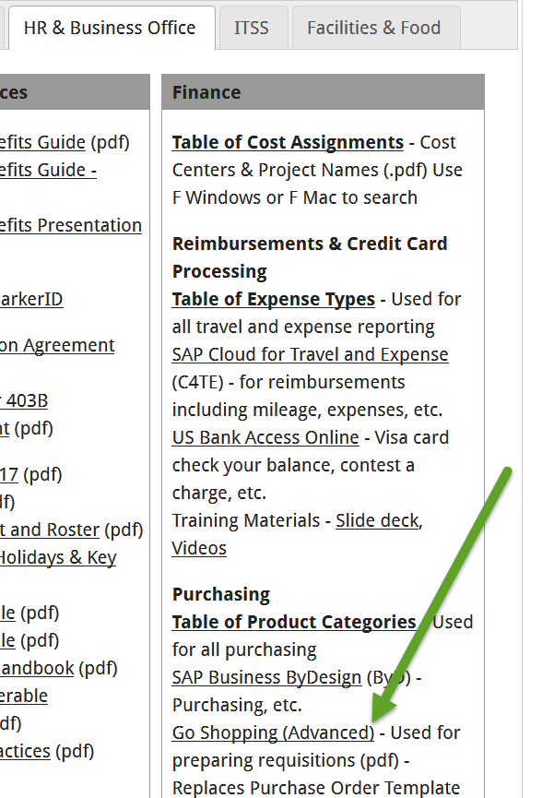
Purchasing
SAP Business ByDesign (ByD)
Operational Now
eRequester Gone
Paper Works!
Still needs Cost Assignment
Needs Product Category

Slide 6
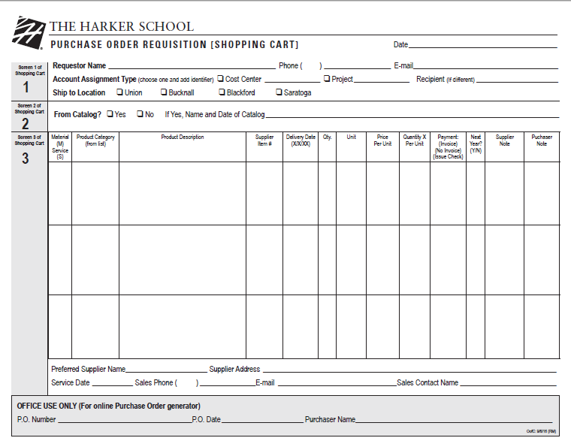
Open and complete the writable pdf
Section 1:
Date, Your name, phone and email
Account assignment and ID from chart
Ship to Campus
Section 2:
Catalog information if relevant
Section 3:
Capital Goods are M for Material, everything else is S for service
Product Category from chart
All else as indicated

Slide 7
Forward Soft Copy to Your Budget Manager
Normally your supervisor
  Send direct from Acrobat Reader
Coming Soon
  Online data entry

Slide 8
Budget Manager Forward to Campus Lead – this is the approval!
Saratoga – Raul Rios
Blackford – Matt Ortiz
Bucknall & Union – Bob Benge
Enter shopping cart into system
Issue Purchase Order
Confirming information for you to follow up
Coming Soon
  Online data entry

